Slide 1
SEEIIST
South East European International Institute for Sustainable Technologies (SEEIIST)
https://seeiist.eu
Facility for Tumour Therapy and Biomedical research with protons and heavier ions
Dr. Sanja Damjanovic
Minister of Science of Montenegro
Chairperson of the SEEIIST Steering Committee
Adria Space Conference, October 3-4, Zagreb, Croatia

Slide 2
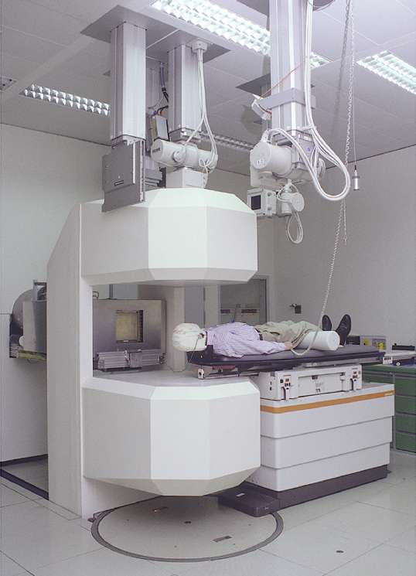
Why are we interested in energetic heavy ions ?
GSI, Darmstadt
Heavy ion radiation is not present naturally on Earth (they are part of the cosmic rays, but are absorbed in the upper atmosphere)
Create energetic heavy ions by accelerators to study DNA effects Dual mission – assure health in deep space and kill cancer cells

Slide 3
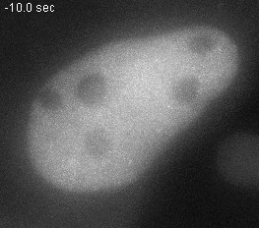
Heavy ion-induced DNA damage
Cosmic rays in human cells
Live cell imaging
Experiment © GSI
Source: slide of Prof. Marco Durante, (Director of the Biophysics Department, GSI-FAIR)
Notes:
Animated gif

Slide 4
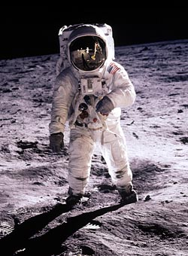
Health in Deep Space
ROUGH GUIDES
Protection from space radiation (particularly very high energy heavy ions)
Psychosocial and behavioural problems
THE ROUGH GUIDE to
Physiological changes caused by microgravity
The Moon & Mars
Source: presentation of Prof. Marco Durante, (Director of the Biophysics Department, GSI-FAIR) at the EPS Council meeting in Split, 2019

Slide 5
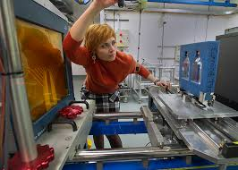
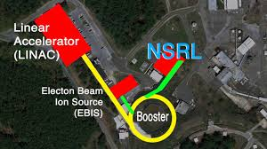
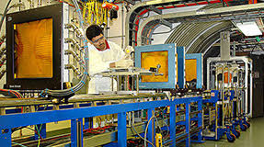
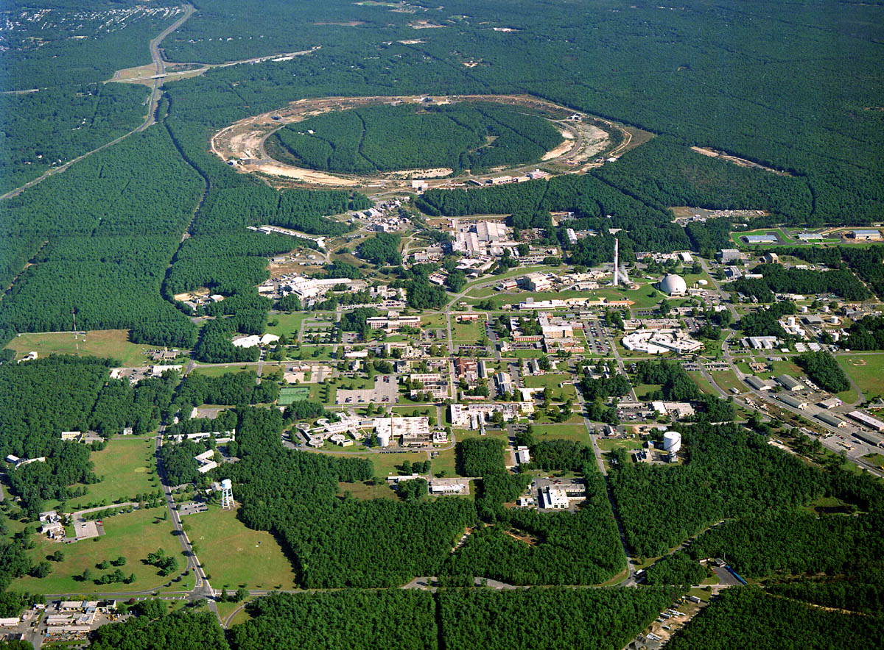
NASA Space Radiation Health Program at BNL
Medical Dept.
Biology Dept.

Slide 6
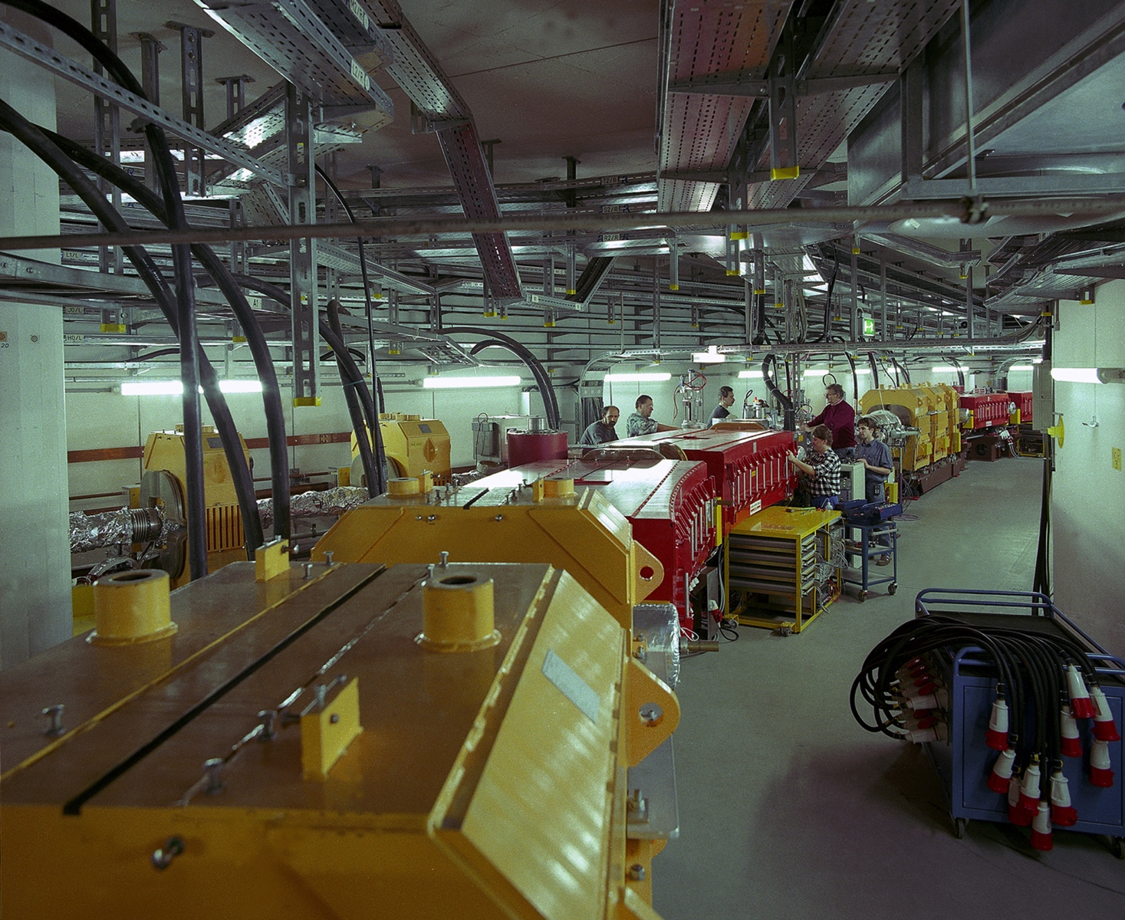
ESA Space Radiation Health Program at FAIR-GSI
An accelerator can simulate cosmic rays on Earth
© A. Zschau, GSI

Slide 7
The Mission of the SEEIIST Project
Create Regional Center of Scientific Excellence with ‘first class research’
To promote collaboration between science, technology and industry (technology transfer)
To provide platform for improved education of young scientists and engineers (knowledge transfer)
To slow down brain drain or even to revert it
Recover the great tradition in technology which SEE had in the past
Foster cooperation between countries in the region
These goals can only be achieved with a Large Scale Facility based on the latest technologies

Slide 8
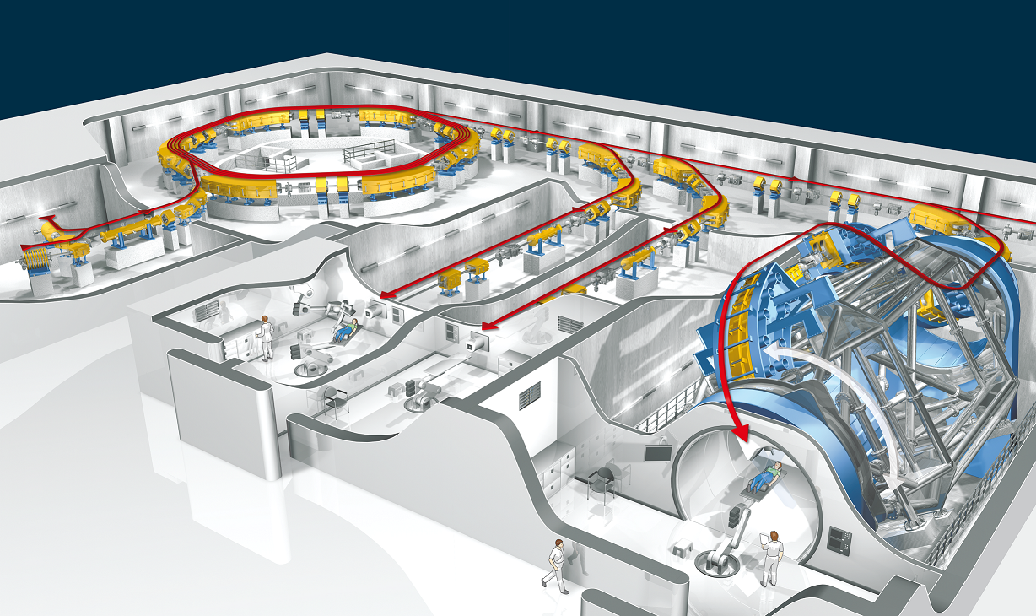
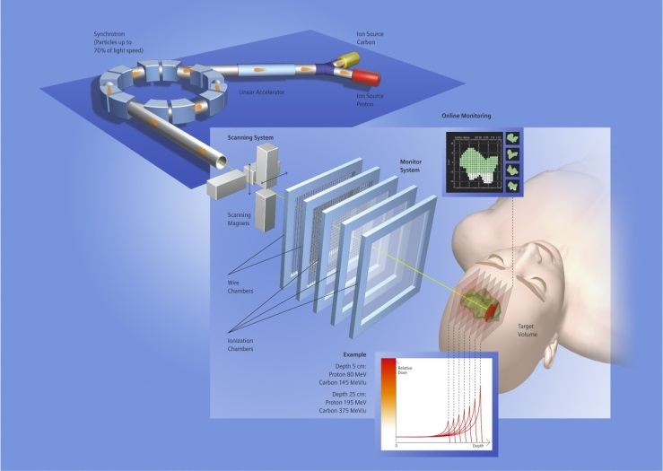
SEEIIST: Facility for Tumour Therapy and Biomedical Research with protons and heavier ions
About 500 patients per year to be treated as needed for a population of 20M. In parallel, 50% of the beam time dedicated to biomedical research with multi-ion sources from H to Ne, making the SEEIIST project unique in the world. Capacity for about 1000 researchers, including a major number from Western Europe.
Example: HIT Heidelberg, first facility in Europe

Slide 9
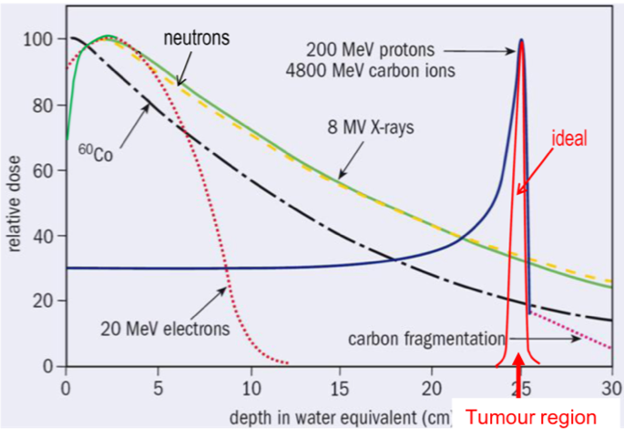
Cancer Therapy with Protons and Heavier Ions
Unique instrument for the treatment of many types of tumours
Deposited dose along the tissue depth
Particle Therapy - Big hole in SEE
source: https://enlight.web.cern.ch
Most important for radioresistant tumours and tumours close to risk organs

Slide 10
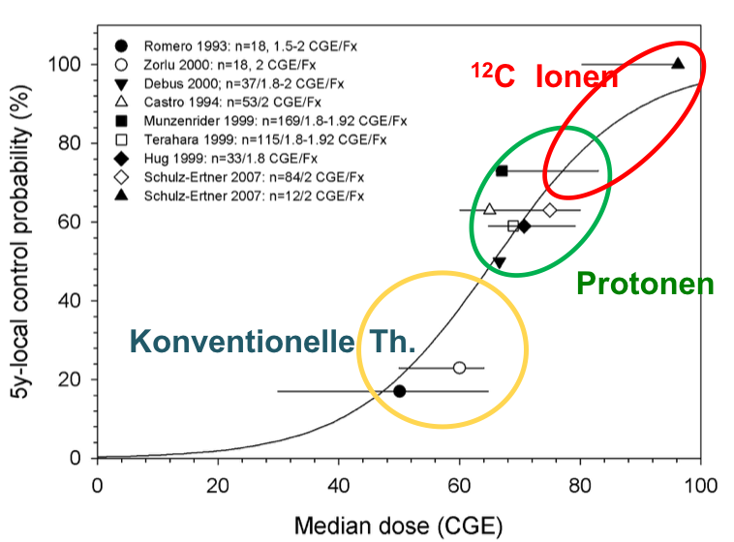
Example of Treatment with Carbon ions
Chordomas of the Skull Base
Survival probability 5 years after treatment

Slide 11
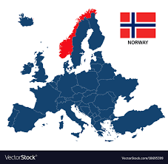
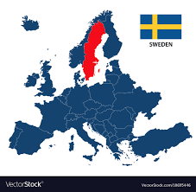
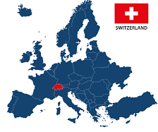
Cancer statistics – mortality/incidence ratio
(all cancers, excluding non-melanoma skin cancers)
Source: Vesna Gershan, Institute of Physics, Skopje
SEEU
The highest 74 % (BIH, ALB, MKD, MNG, GR )
The lowest 50% (SLO)
EU
The highest 64% (Hungary, Lithuania)
The lowest 34% (Norway, Sweden, Switzerland)
Less imaging and treatment equipment – one of several factors for higher Mortality/Incidence ratio

Slide 12
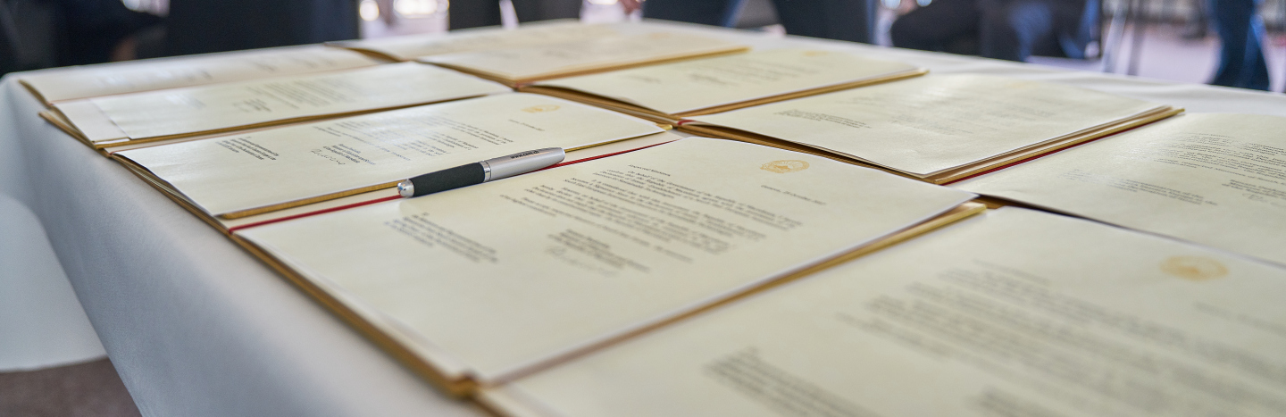
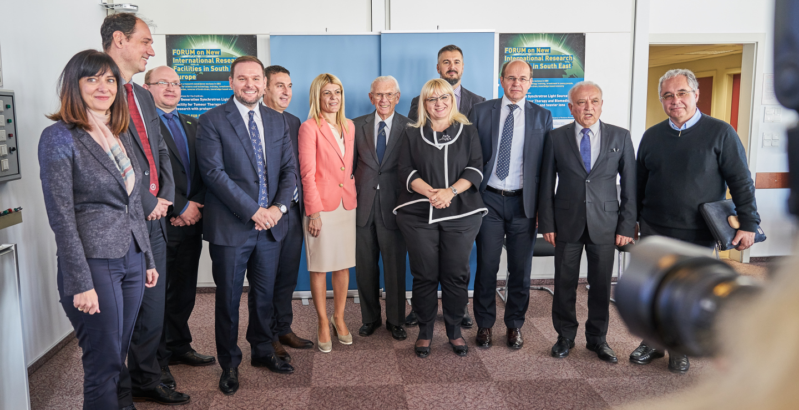
SEEIIST
Political steps taken so far
Declaration of Intent signed at CERN on October 25, 2017
First official support of such an initiative by the Government of Montenegro in March 2017
Signature of Declaration
of Intent by SEE Ministers
of Science/corresponding Ministers or their representatives at CERN
SEEIIST Initiative transformed into a Regional Project

Slide 13
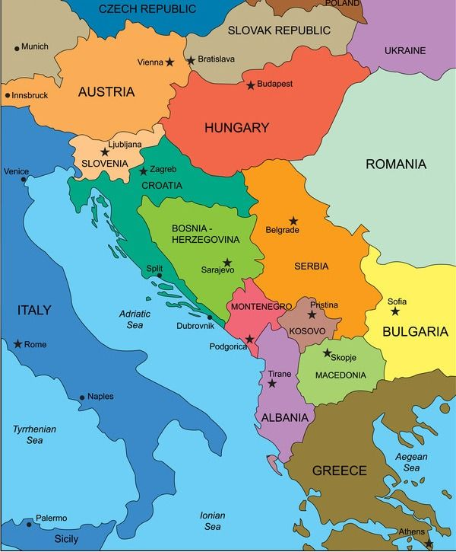
Candidate Members for the South-East European International Institute for Sustainable Technologies
Republic of Albania
Signed a Declaration of Intent
Agreed ‘ad referendum’
Bosnia and Herzegovina
Observer
Republic of Bulgaria
Republic of Croatia
Hellenic Republic
Kosovo*
North Macedonia
Montenegro
Republic of Serbia
Republic of Slovenia

Slide 14
Important support for the SEEIIST Design Phase
European Commission – Directorate General for Research and Innovation (EC DG-RTD)
Strong recognition of the Project by the Commissioner Moedas
First direct financial support of 1 MEUR for the 1st stage of Design Study Phase
CERN – European Organization for Nuclear Research
Hosts the Working Group 1 – Accelerator Design – part of the SEEIIST Design Study Phase
Great benefit from long experience in the design of medical accelerators
GSI-FAIR – Facility for Antiproton and Ion Research
Hosts the Working Group 2 – R&D and Scientific Aspects of the SEEIIST Design Study Phase
Great benefit from long experience in Bio- and Medical Physics
IAEA – International Atomic Energy Agency
Support by the IAEA for the Capacity building program

Slide 15
SEEIIST
Another Political Milestone for SEEIIST
Memorandum of Cooperation signed by six Prime Ministers of the SEE Region
Signature of Memorandum on 5 July 2019 in Poznan, Poland at the occasion of the 6th Summit of the Berlin Process

Slide 16
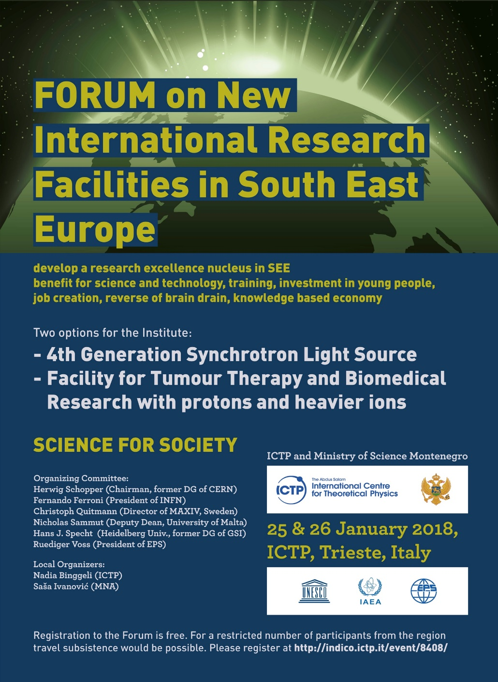
Concept Study of the SEEIIST worked out over the year 2017
Forum held at the ICTP/Trieste on 25-26 January 2018
Scientific Concept Studies presented for the first time
to the public
More that 100 participants
including 40 Users from the Region
The SEEIIST Concept Study will
soon be available in the form of
a CERN Yellow Report
Representatives from the EC, ESFRI, IAEA, EPS, RCC, CERN, FAIR-GSI, HIT, CNAO, DESY, SESAME….

Slide 17
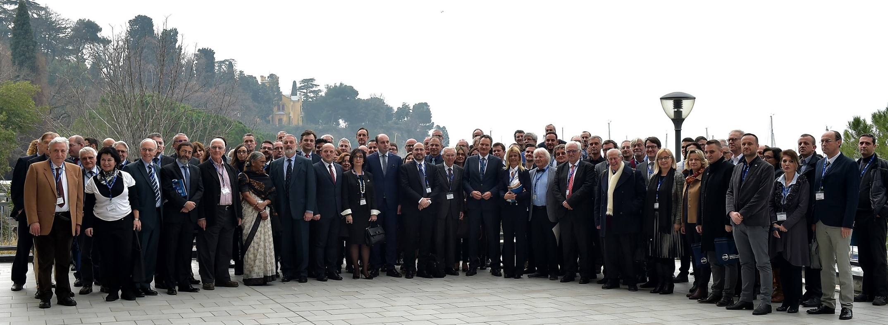
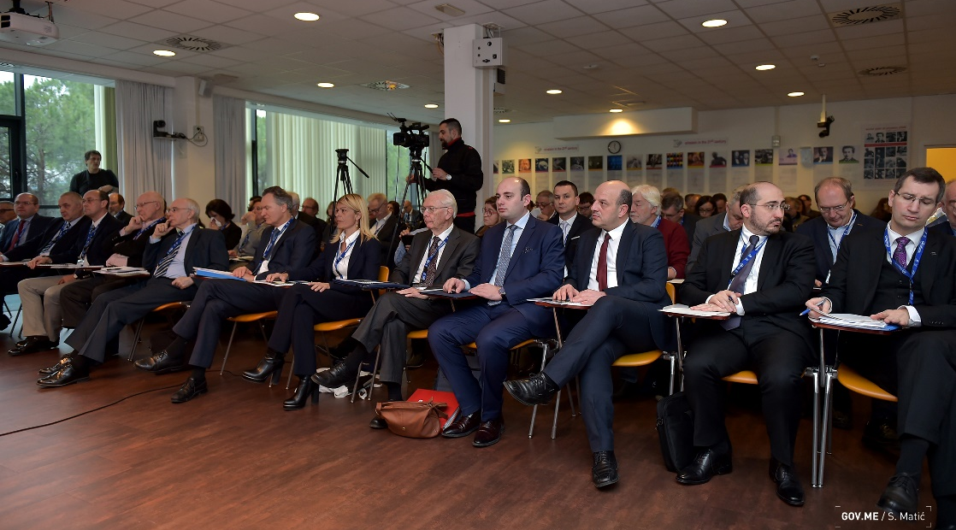
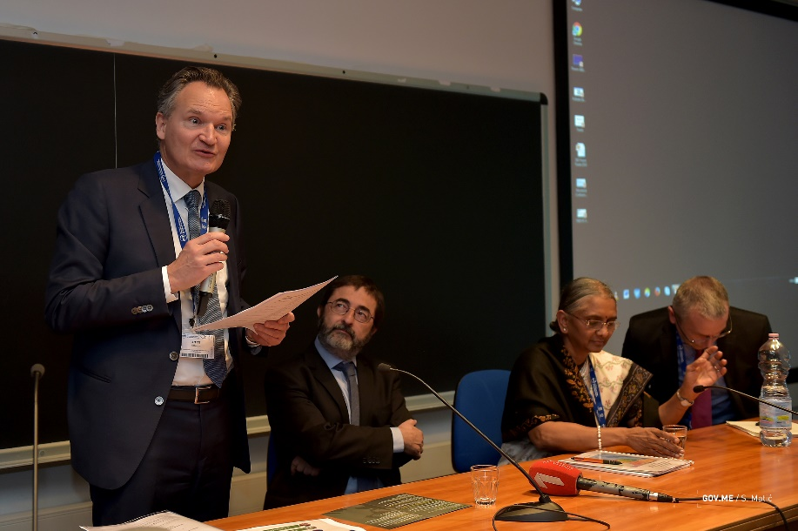
Forum on New International Research Facilities in South East Europe, ICTP, Trieste 25-26 January 2018

Slide 18
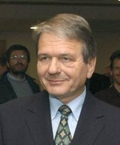
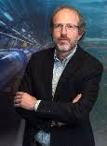
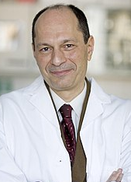
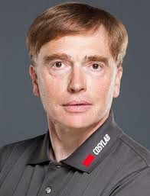
SEEIIST – Actions in Place
Preparatory Group for the SEEIIST Design Study Phase
for 18 months (Phase 1) has been setup
Overall Responsibility:
SEEIIST Steering Committee
Overall coordinator of the Preparatory Group
Dr. Horst Wenninger
Overall Coordinator:
Dr. Horst Wenninger (CERN)
Working Group 1
Accelerator Design
at CERN
Working Group 2
R&D/Scientific Aspects at FAIR-GSI
Working Group 3
Legal Aspects
+ Business Plan SEEIIST SC
WG1 Coordinator:
Dr. Maurizio Vretenar (CERN)
WG2 Coordinator:
Dr. Marco Durante (GSI)
WG3 Coordinator:
Dr. Mark Plesko (CosyLab)
SCIENCE FOR DIPLOMACY
SCIENCE FOR SOCIETY

Slide 19
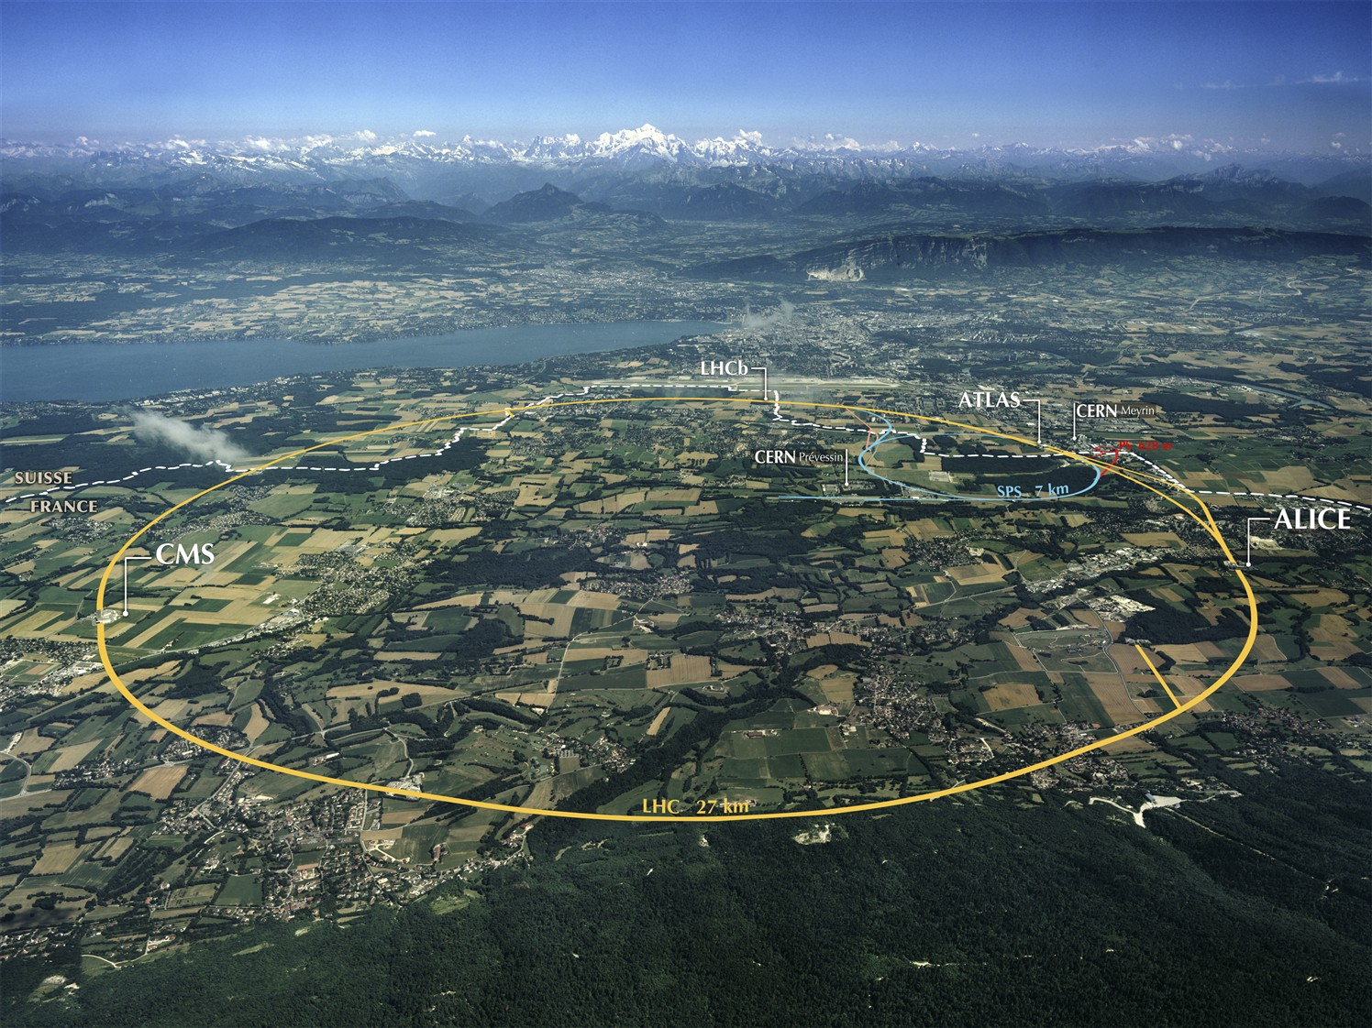
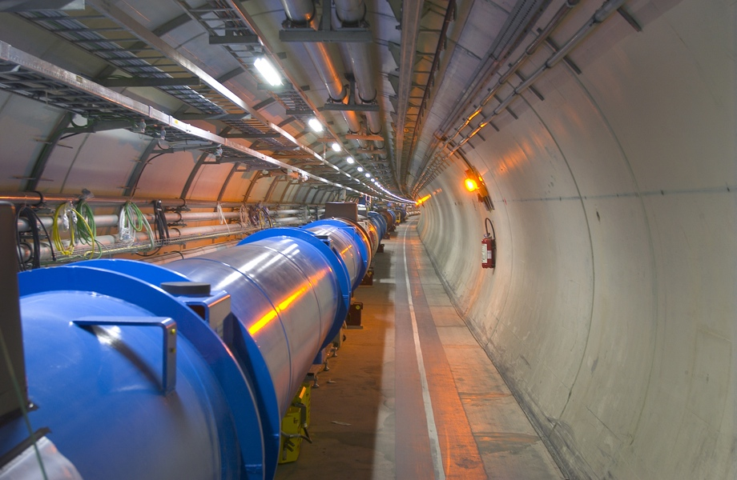
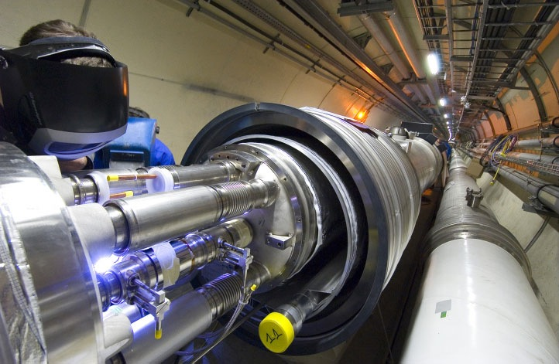
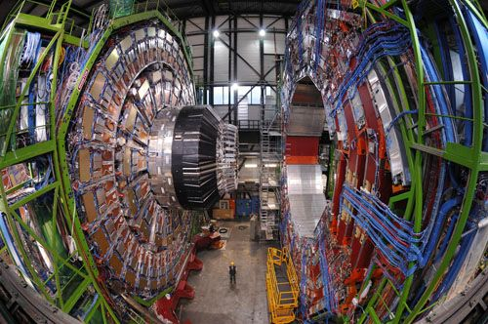
SEEIIST
SEEIIST Accelerator Design - hosted at CERN
Objectives:
CERN
accelerating science and innovation
SEEIIST is in the best hands in what concerns the development
of an innovative design of a light-ion medical accelerator

Slide 20
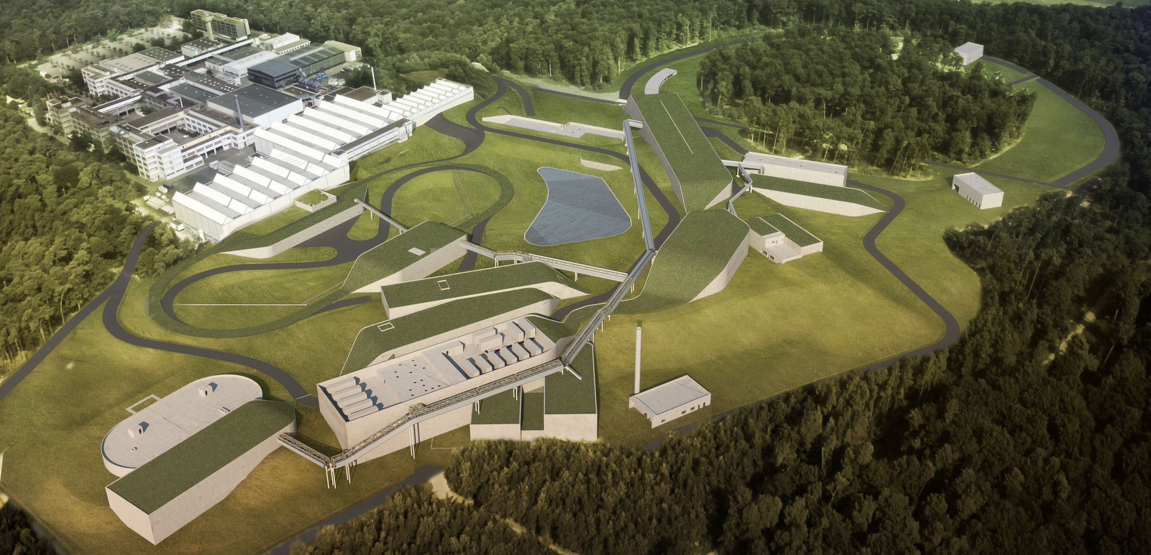
SEEIIST
SEEIIST R&D/Scientific Aspects – hosted by FAIR-GSI
SEEIIST is in the best hands in what concerns clinical research, pre-clinical radiobiology, imaging and medical physics

Slide 21
SEEIIST – Actions in Place
SEEIIST Design Phase for the first 18 months (Phase 1) has already started
HITRI – Hadron Ion Therapy Research Infrastructure – Design Study Proposal via EU H2020 INFRADEV-01-2019-2020 call - under preparation
As of August 2019 SEEIIST is a legal entity – Association via Swiss law
Building Innovative Capacity in South East Europe in a cutting edge field such as Hadron Therapy: - IAEA TC RER Project 0.5 MEUR prepared; - COST application just submitted; - Started preparation for MC-ITN Call – Leveraging on ENLIGHT and the SEEIIST Project
Planning preparation for the ESFRI Roadmap
SCIENCE FOR DIPLOMACY
SCIENCE FOR SOCIETY

Slide 22
SEEIIST
HITRI – Hadron Ion Therapy Research Infrastructure
Design Study Proposal – EU H2020 INFRADEV-01-2019-2020 call
TIARA prepared
to give advice
HITRI Consortium
Several beneficiaries from SEE Region through SEEIIST

Slide 23
Additional drivers and missions for setting up the SEEIIST
No matter where SEEIIST will be located
– National benefits across the whole Region –
Treatment of patients: all participating parties will have their share for the treatment of patients
Involving the local industry: the construction of the Facility would require more than 200 companies. The production of many different components can preferentially be assigned to our local industry.
Powerful digital networks and big data handling - to reach the clinical and scientific goals two Networks will be set up, a Clinical- and a Scientific Network, to be located in different parts of the region
Training for building innovative capacity in South East Europe – all countries involved - Funding from IAEA, COST, MC ITN, IPA2020

Slide 24
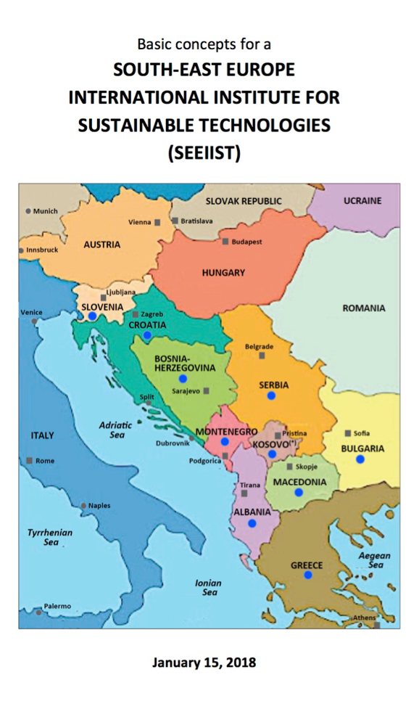
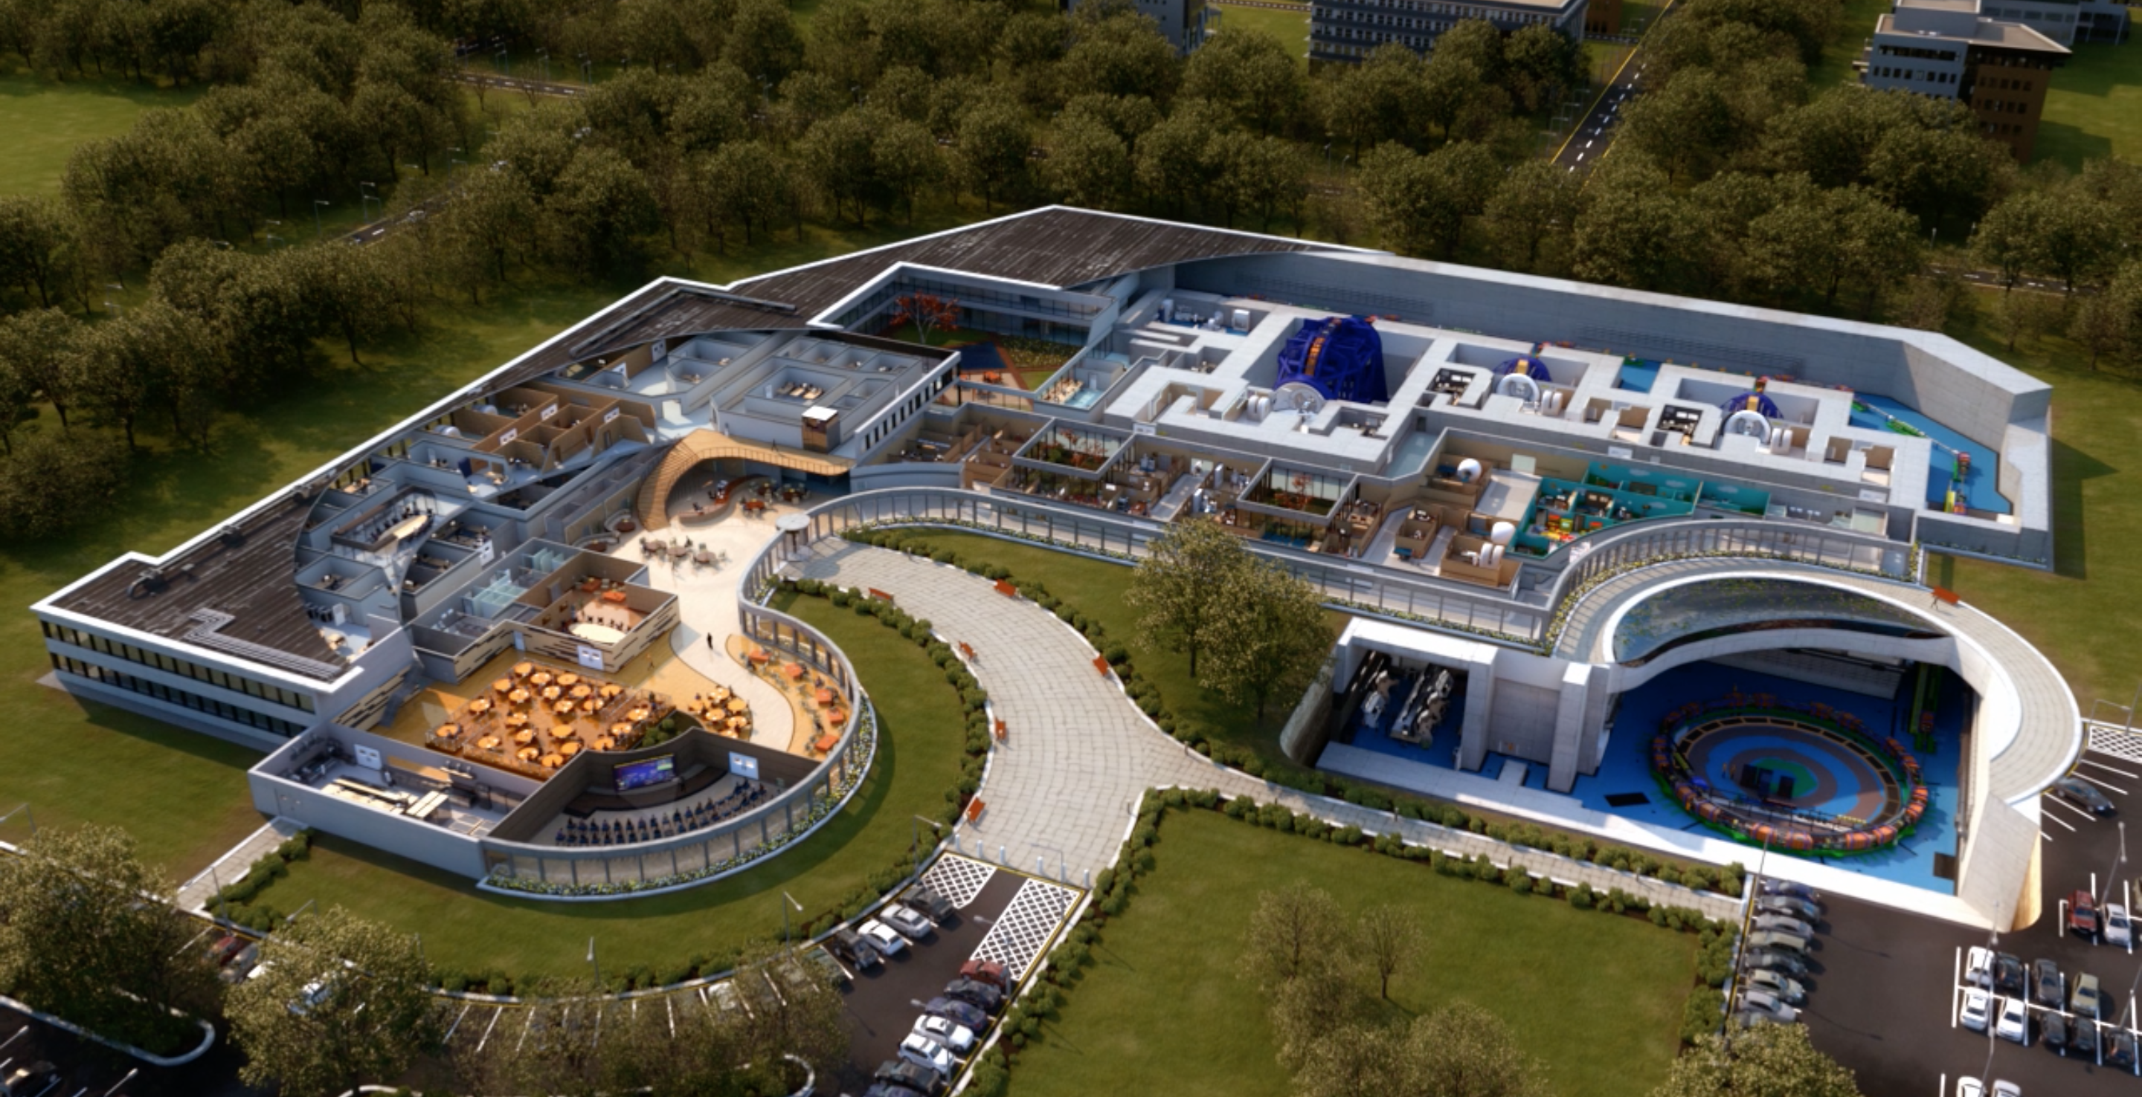
Time line of the SEEIIST Project
2019:
Start of the Design Study Phase
Application for Design-Study-Call INFRADEV-01-2019-2020
2020/21:
Selection of the site
Application for the
ESFRI Road Map
2028:
First patient treatments
2023:
Start construction of the Facility
For SEEIIST up to 200 MEUR required, guaranteeing
competitivity in Europe. Multiple sources of financing
necessary: EU Structural and cohesion funds, IPA funds, some contributions from member-states, other investment funds
2017-2018: Concept Studies

Slide 25
SEEIIST
Europe needs to further advance in ion therapy
‘A multiple-ion tumour therapy and research facility’ based on innovative accelerator technologies
Politically widely accepted that the SEE region needs economic help and further stabilization
Multiple-ion tumour therapy with a large fraction of beam time dedicated to biomedical research in South East Europe will be a benefit for all EUROPE
SCIENCE FOR DIPLOMACY
25
SCIENCE FOR SOCIETY

Slide 26
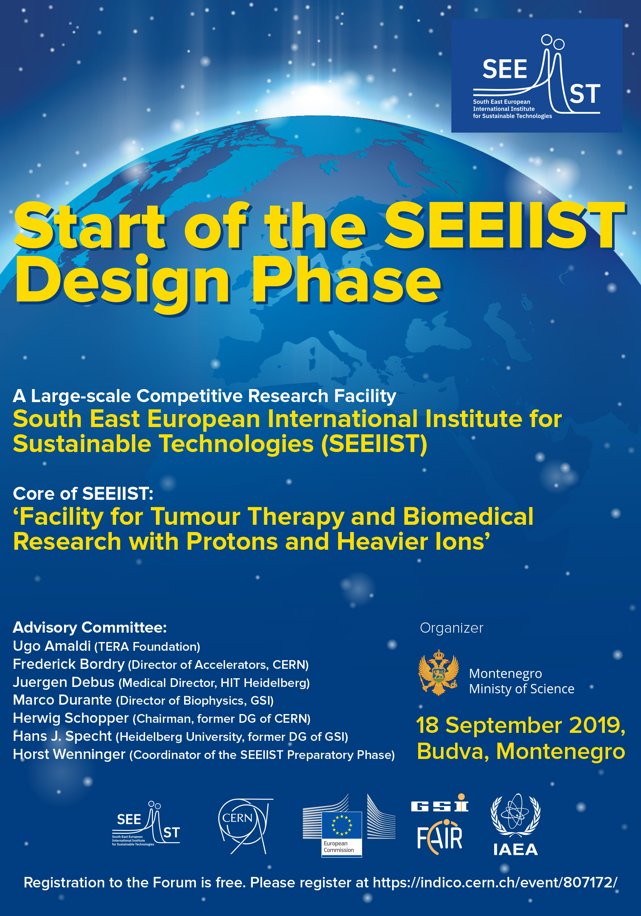
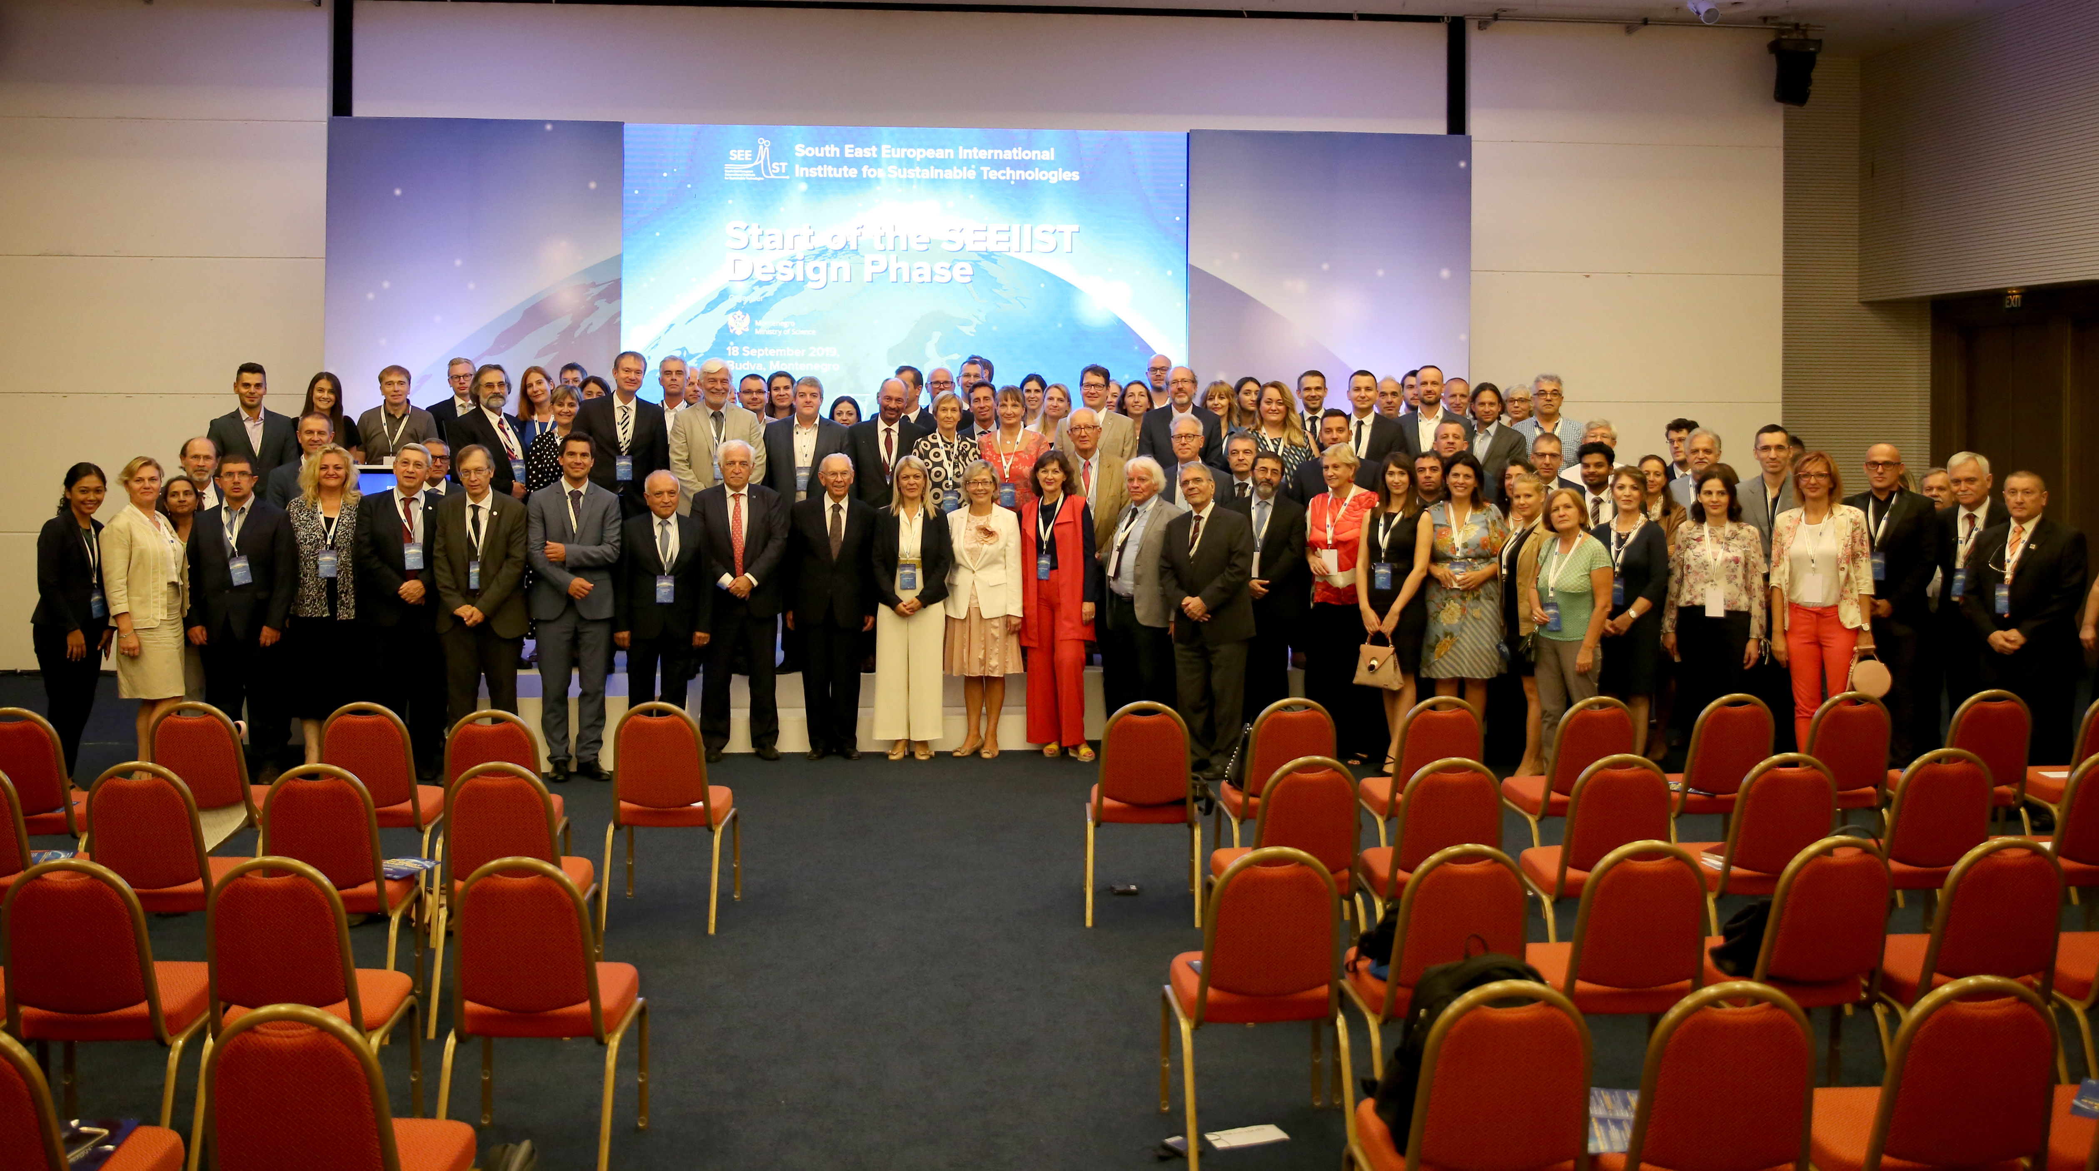
SCIENCE FOR DIPLOMACY
SCIENCE FOR SOCIETY
We have organized a special event ’Start of the SEEIIST Design Phase’ on 18 September 2019 in Budva, Montenegro
Purpose of event – to inform the public about the advancement of the SEEIIST Project at a decisive moment when it passes from the Phase of Conception to the Phase of Design
The website of the event: https://indico.cern.ch/event/807172

